Slide 1
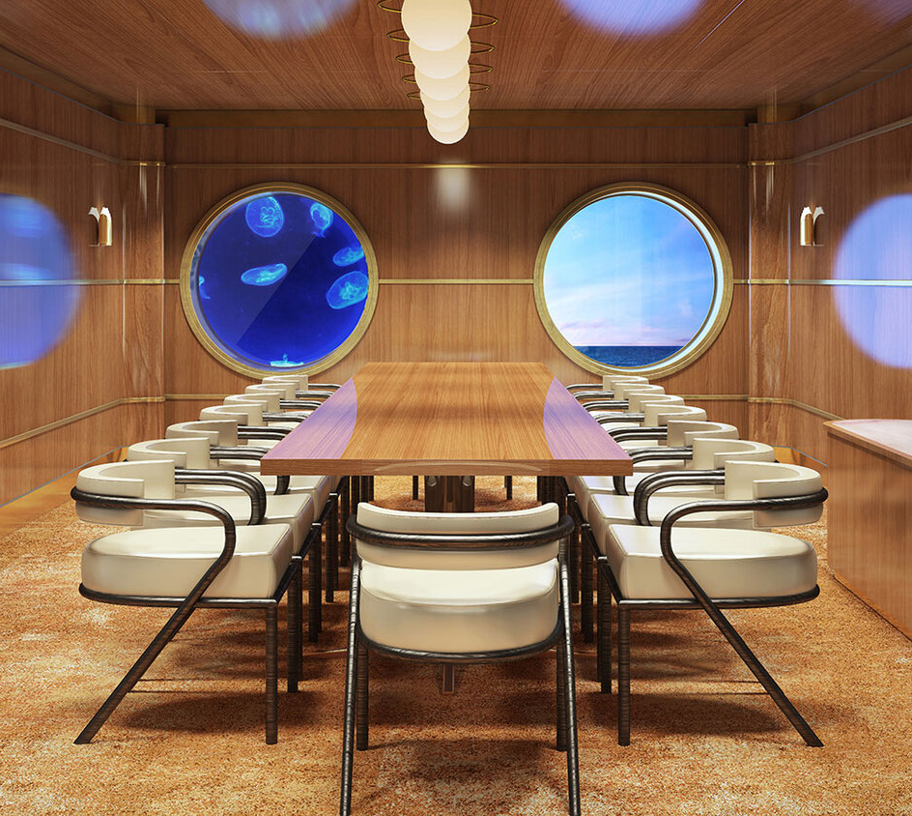
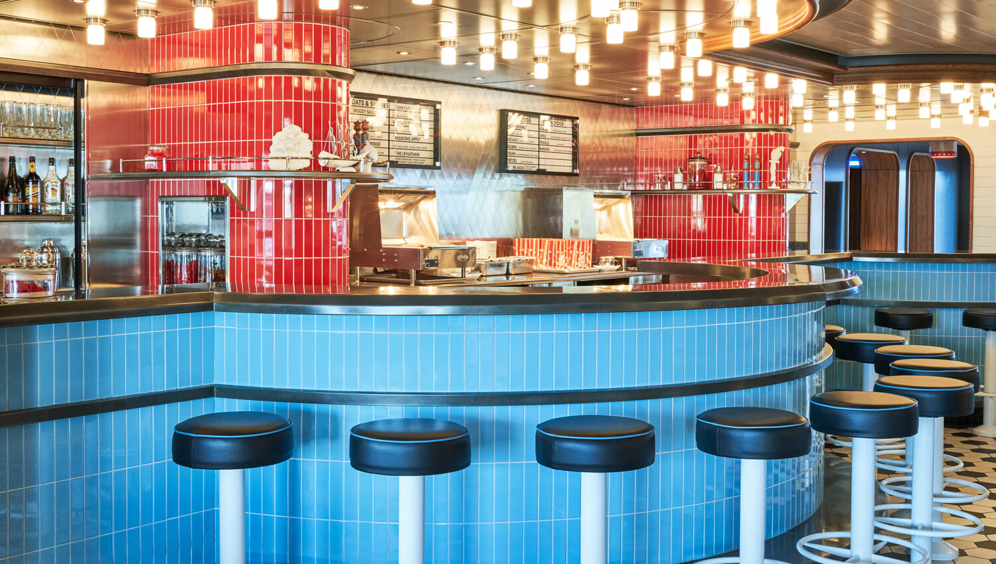
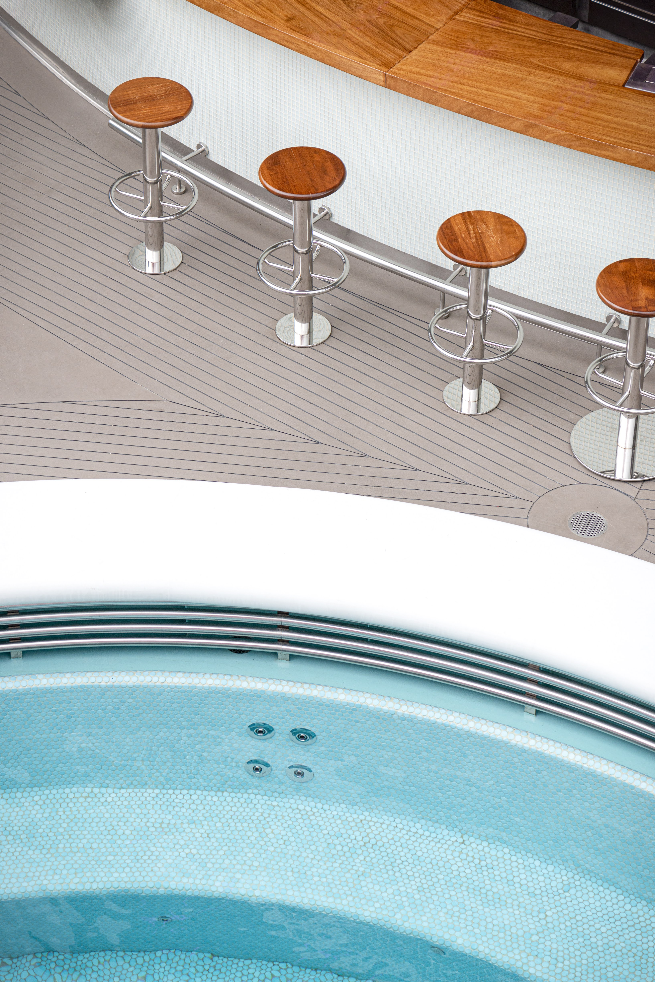
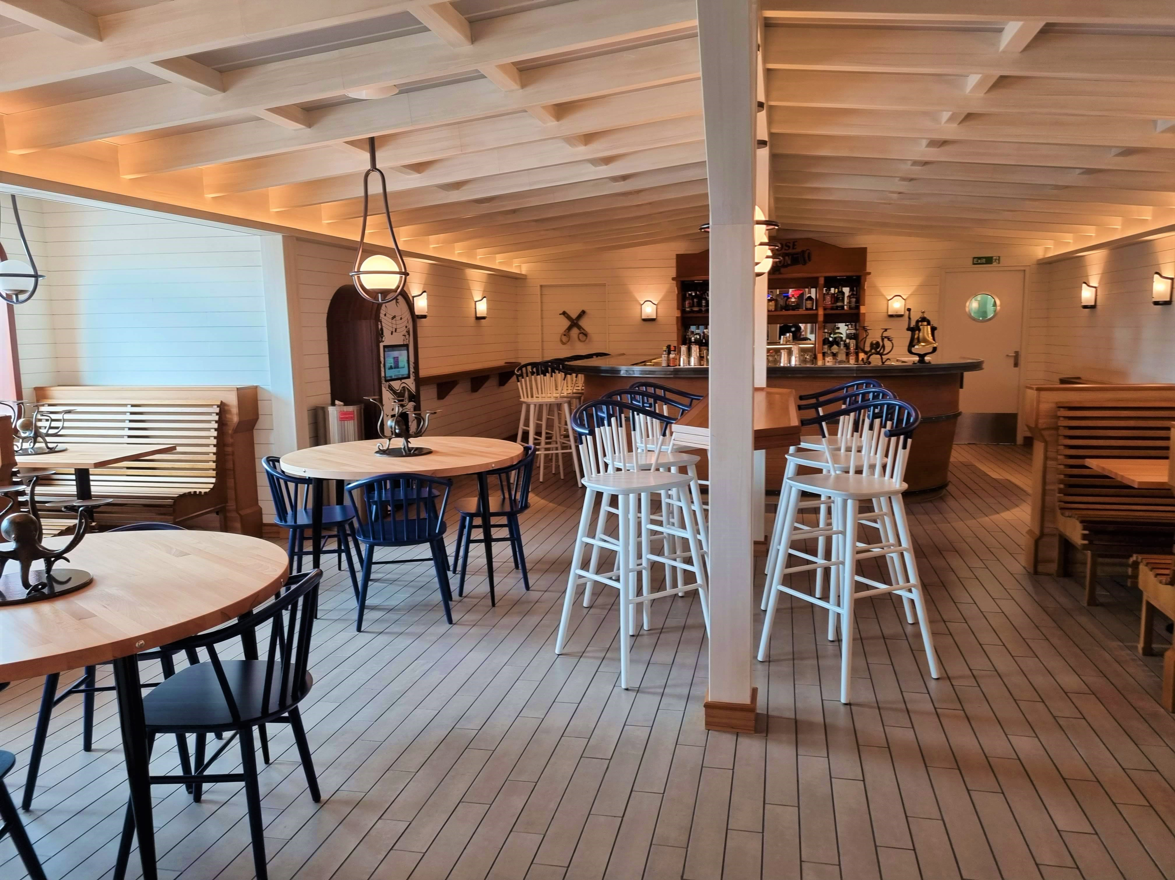
Making places for everyone
VIRGIN VOYAGES have appointed us as the furniture manufacturer for majority of the furniture on the vessels, Scarlet Lady, Valiant Lady and Resilient Lady have all been completed.
Virgin Voyages
MIAMI
tableplacechairs.com

Slide 2
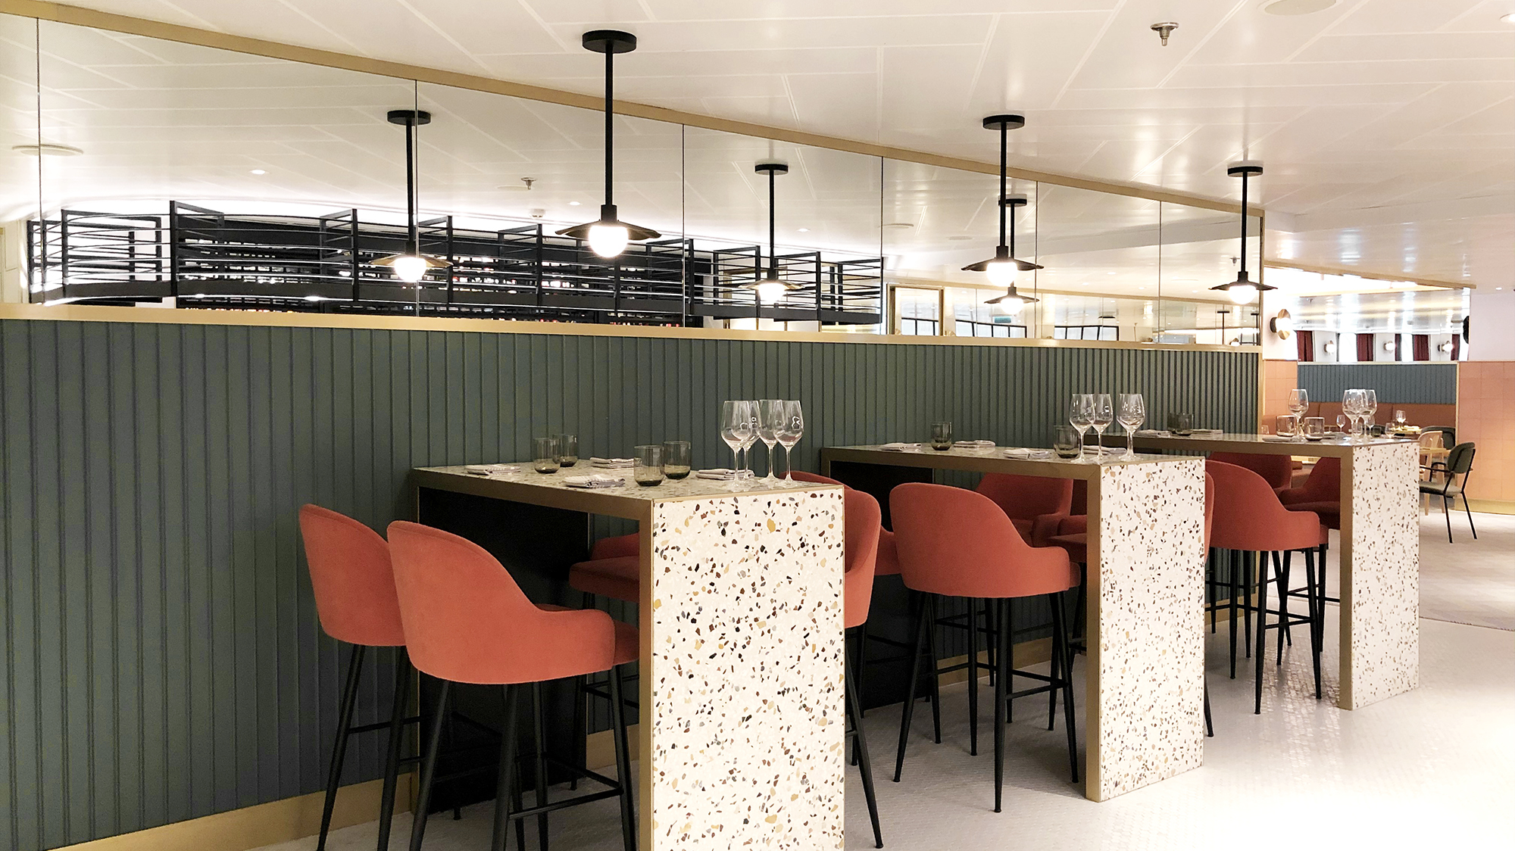
Making places for everyone
VIRGIN VOYAGES
MIAMI
tableplacechairs.com

Slide 3
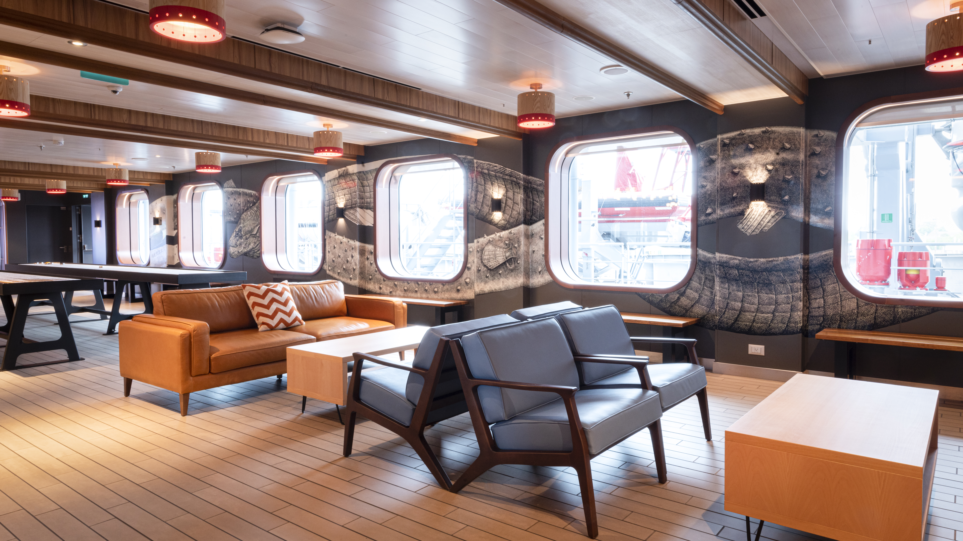
Making places for everyone
VIRGIN VOYAGES
MIAMI
tableplacechairs.com

Slide 4
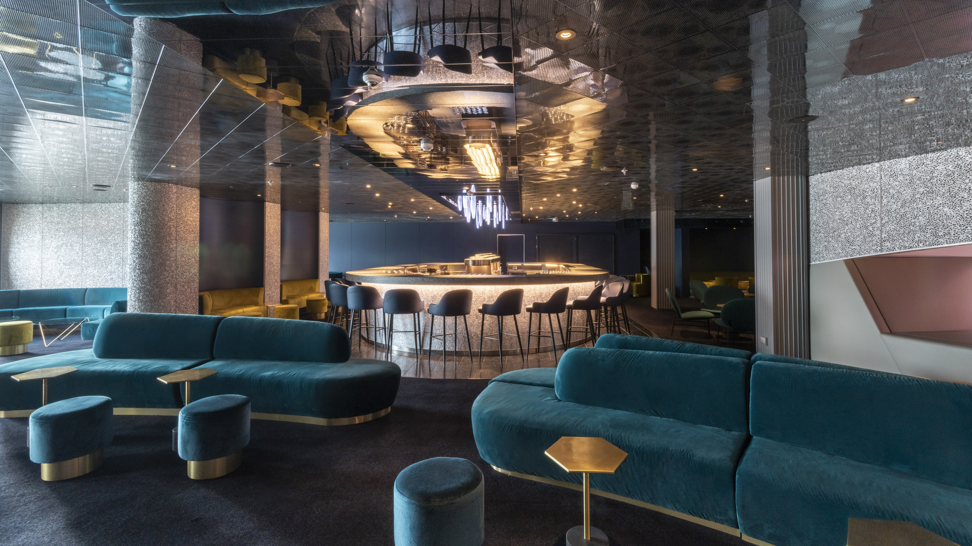
Making places for everyone
VIRGIN VOYAGES
MIAMI
tableplacechairs.com

Slide 5
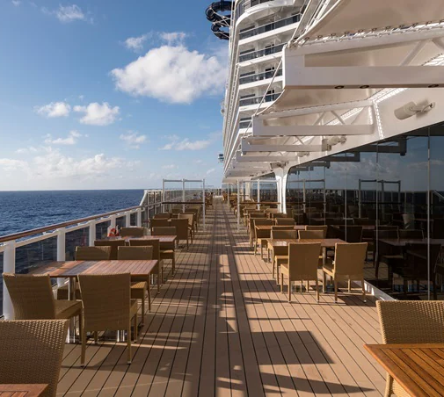
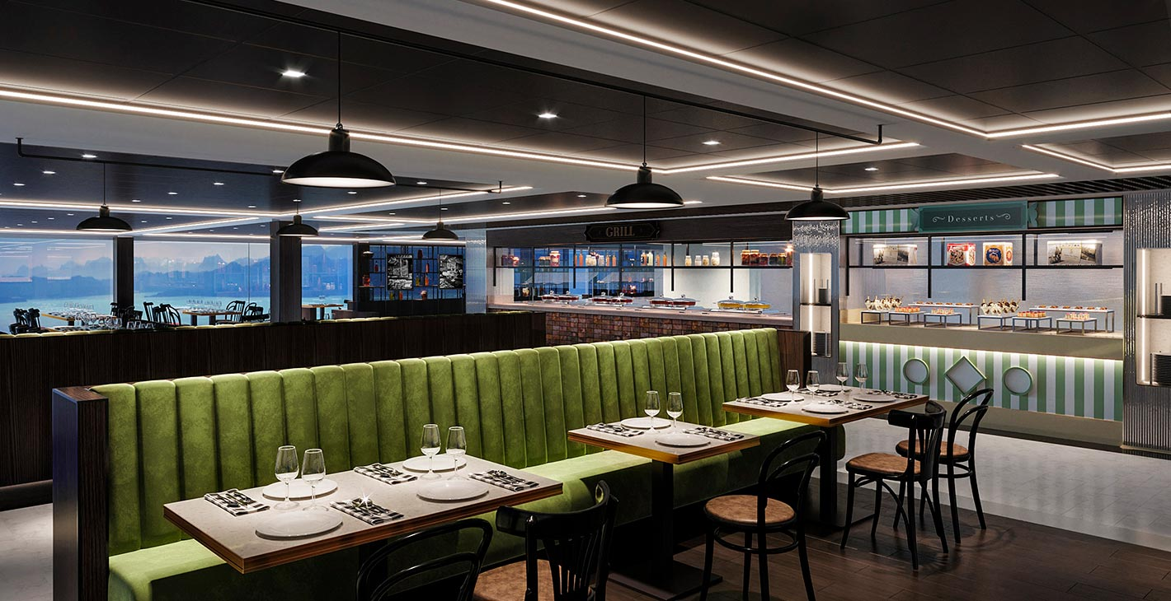
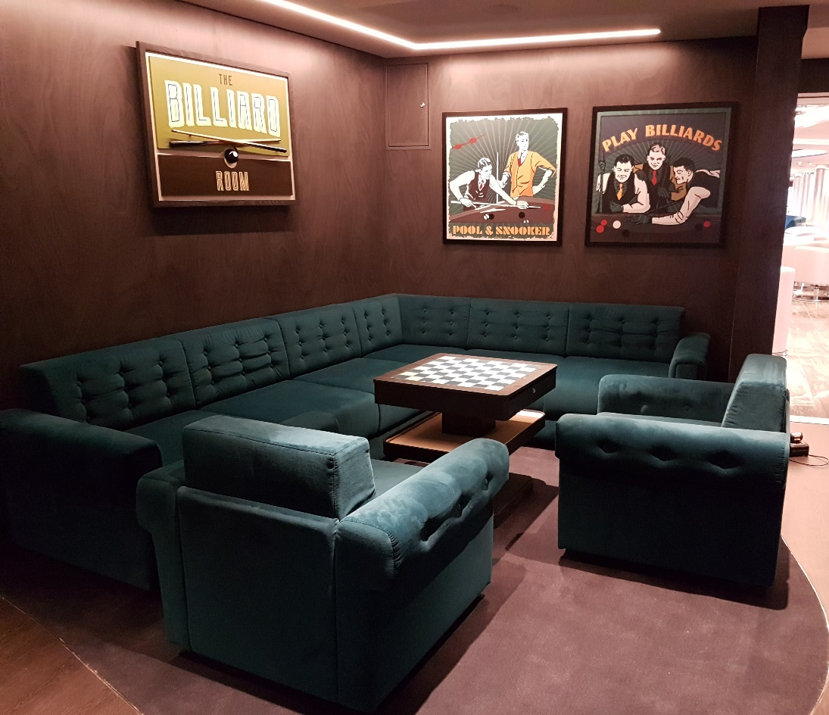
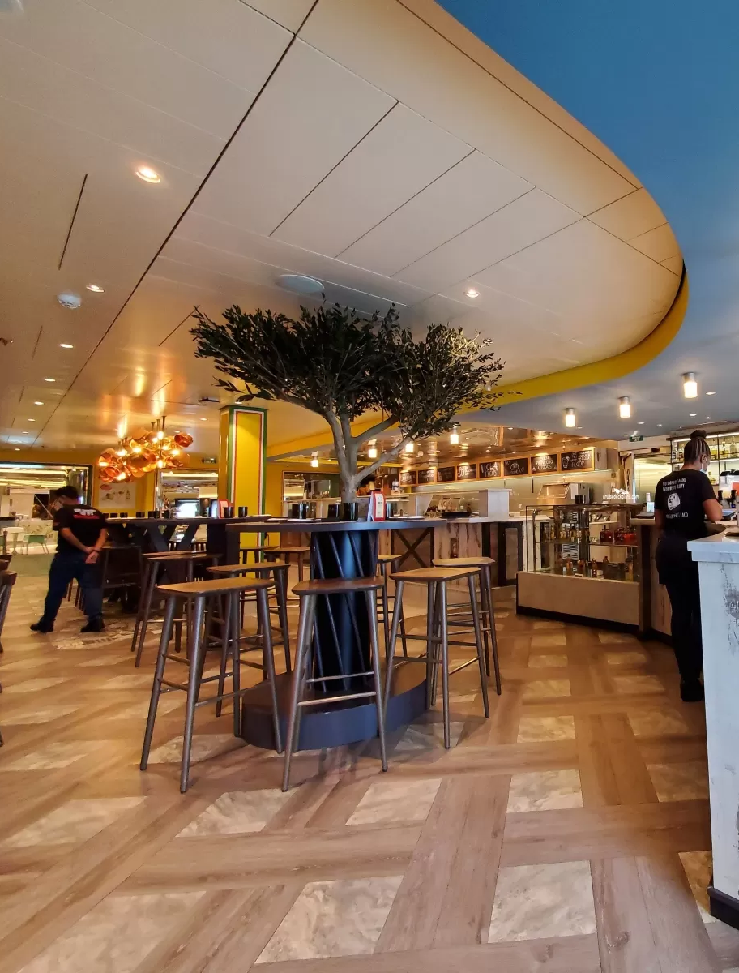
Making places for everyone
MSC SEAVIEW we supplied and fitted the deck external tables and worked on a number of the internal bars and restaurants.
Shipyard: Fincantieri
Brands: Hola Tacos, Fish restaurant, MSC lounges
MSC SEAVIEW
ITALY
tableplacechairs.com

Slide 6
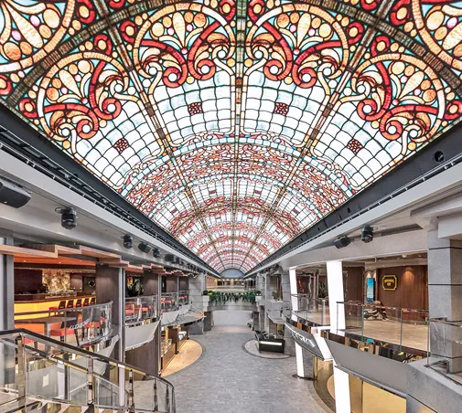
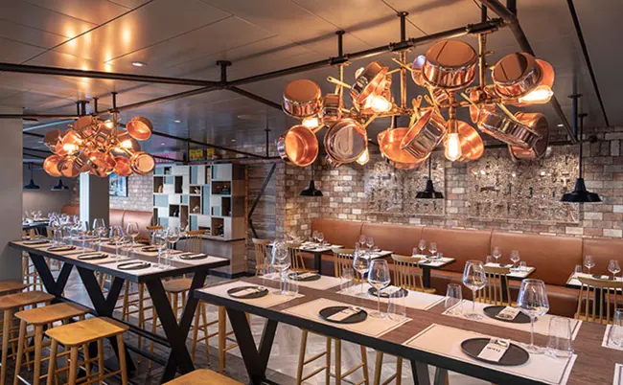
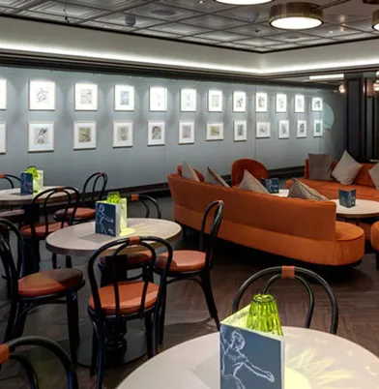
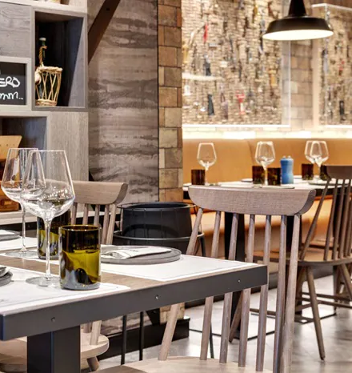
Making places for everyone
MSC MERAVIGLIA we supplied over 2000 bespoke tables and dining chairs along with a number of the restaurants.
Shipyard: Fincantieri
Brands: MSC lounges & public space
MSC MERAVIGLIA
ITALY
tableplacechairs.com

Slide 7
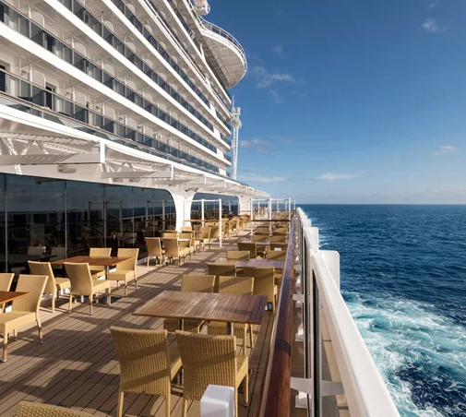
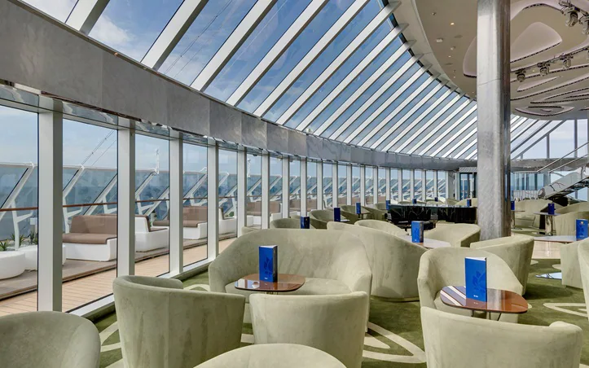
Making places for everyone
MSC SEASIDE we supplied the outdoor deck furniture along with some of the lounges and dining furniture.
Shipyard: Fincantieri
Brands: MSC lounges & public space
MSC SEASIDE
ITALY
tableplacechairs.com

